Slide 1
NEURAL NETWORKS

Slide 2
TODAY’S LEARNING OBJECTIVES
NEURAL NETWORKS
Understand the concepts behind perceptrons and hidden layers
Understand back propagation

Slide 3

NEURAL NETWORKS
“To understand Neural Networks, you need to understand where they came from”

Slide 4
INTRODUCTION
HISTORY

Slide 5
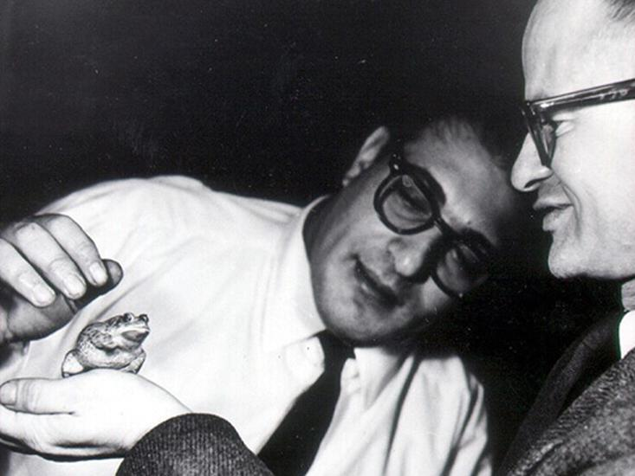
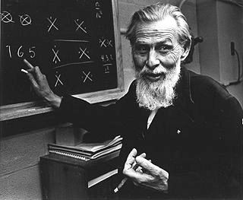
NEURAL NETWORKS
McCulloch was a confident, gray-eyed, wild-bearded, chain-smoking philosopher-poet who lived on whiskey and ice cream and never went to bed before 4 a.m.
At the age of 12, after reading Principia Mathematica he sent a letter to Bertrand Russell pointing out what he considered serious problems with the first half of the first volume
Walter Pitts
Warren McCulloch
Proposed that all of mathematics could be built from the ground up using basic logic. Their building block was the proposition – the simplest possible statement, either true or false.
From there, they employed the fundamental operations of logic, like ‘and’, ‘or’, and ‘not’
http://nautil.us/issue/21/information/the-man-who-tried-to-redeem-the-world-with-logic

Slide 6
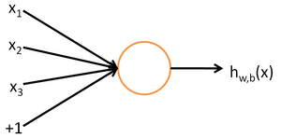
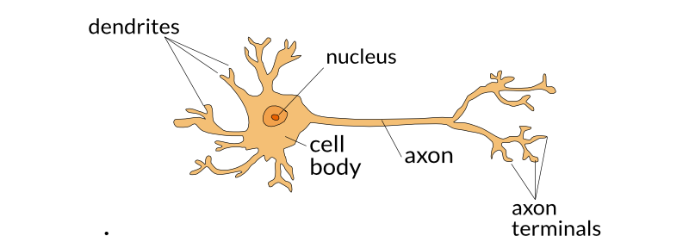
NEURAL NETWORKS
Neurons – They act like a ‘true’ or ‘false’?
They only fire after a minimum threshold has been reached
A neuron’s signal is a proposition and they work like logic gates where they take in multiple inputs and produce a single output
http://nautil.us/issue/21/information/the-man-who-tried-to-redeem-the-world-with-logic

Slide 7
NEURAL NETWORKS
Example: Where will you go out for lunch?
What are some of the inputs to making that decision?
You will make a decision if and only if enough criteria are satisfied
http://nautil.us/issue/21/information/the-man-who-tried-to-redeem-the-world-with-logic

Slide 8
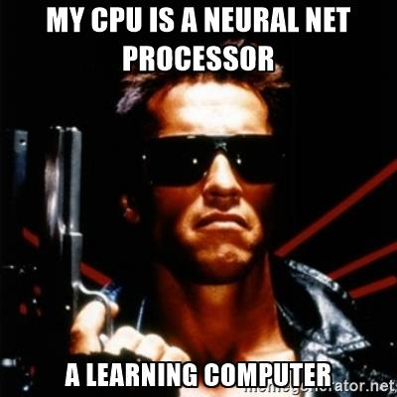
NEURAL NETWORKS
McCulloch became convinced that the brain was just such a machine – one which uses logic encoded in neural networks to compute
Neurons could be linked together by the rules of logic to build more complex chains of thought
http://nautil.us/issue/21/information/the-man-who-tried-to-redeem-the-world-with-logic

Slide 9
INTRODUCTION
NEURAL NETWORKS

Slide 10
NEURAL NETWORKS
A Neural Network is a highly interconnected network of information-processing elements that mimics the connectivity and functioning of the human brain.
Supervised and Unsupervised learning algorithm
Advances in computer processing power and storage (database) are finally allowing neural nets to improve solutions for complex problems such as speech recognition, computer vision, and Natural Language Processing (NLP)
We will go over how its used in classification

Slide 11
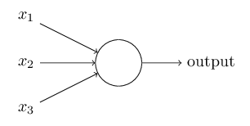
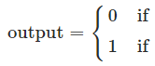
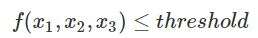
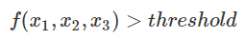
NEURAL NETWORKS
To mimic the behavior of neurons, we use something called a perceptron – they take several inputs (x1, x2, …) and produce a single binary output
Think of perceptrons as a method for weighing evidence to make decisions
Decision Function
Input Variables
http://neuralnetworksanddeeplearning.com/chap1.html

Slide 12
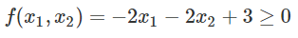
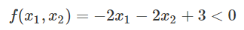
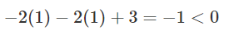
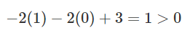
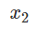
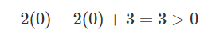
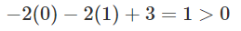
NEURAL NETWORKS
Example: let’s say we have two input variables and the output is based on the following function:
Suppose x1 and x2 are binary. Let’s look at the different possible outputs:
x1 = 1, x2 = 1
x1 = 1, x2 = 0
x1 = 0, x2 = 0
x1 = 0, x2 = 1
Output = ?
Output
Output = ?
Output = ?
Output = ?

Slide 13
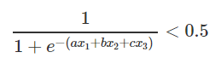
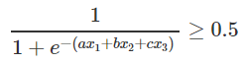
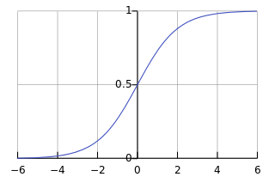
NEURAL NETWORKS
Another example of a neural network with one perceptron is a Logistic Regression
The decision function is based on the sigmoid function where the output is bounded between 0 and 1.
The linear combination of coefficients with input values gives you one decision boundary.

Slide 14

NEURAL NETWORKS
Our brains have many neurons. Therefore, we can also have many perceptrons in a neural network.
We can also have several layers of perceptrons - we call them hidden layers
We choose both the # of layers and # of perceptrons in each layer.
In this example, the perceptrons in the hidden layer are making four decisions based on the input variables.
Hidden layers have binary values
http://neuralnetworksanddeeplearning.com/chap1.html

Slide 15
KNOWLEDGE CHECK
What is a neural network supposed to mimic?
What is a perceptron? How does it make decisions?
What is an example of a neural network with just one perceptron?

Slide 16
INTRODUCTION
EXAMPLE

Slide 17
NEURAL NETWORKS
Example
Suppose you want to use a neural network to classify whether a point is a circle or square with two features, x1 and x2.
X2
How would a neural network fit this data?
X1

Slide 18
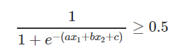
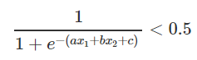
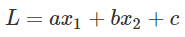
NEURAL NETWORKS
Example
The points could be separated with one decision boundary AKA one perceptron
This decision boundary could be derived using Logistic Regression
X2
Output
Square if
Output =
Circle if
X1
The decision boundary is derived the same way as in Logistic Regression using Gradient Descent

Slide 19
NEURAL NETWORKS
How does a neural network come up with the decision boundary?
X2
X1

Slide 20
INTRODUCTION
BACK PROPAGATION

Slide 21
BACK PROPAGATION
What is it? The process in which we determine our decision boundaries for classification
We use the same process for finding the decision boundary in Logistic Regression.
How does it work?
A set of training examples is given: {(x, d)*} where x is the input and d the target output [supervised learning]
2. Examples are presented to the network.
For each example, the network gives an output y.
If there is an error, the decision boundary/line is moved in order to correct the output error.
We adjust the boundary using Gradient Descent
When the error has reached a minimum threshold, Stop learning.

Slide 22
INTRODUCTION
GRADIENT DESCENT
REFRESHER

Slide 23
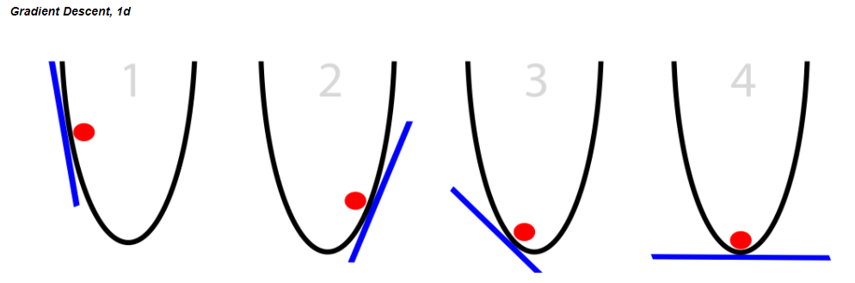
GRADIENT DESCENT
Gradient Descent is an iterative process that we use to pick our decision boundary
You can see it as almost a guess and check – do these sets of coefficients minimize the error between my guess and the true point? If no, then keep looking for better coefficients. If yes, then stop!
The y-axis represents the residuals AKA the cost function, and the x-axis represents our parameters for the decision boundary
Notice how there is only one point that minimizes the cost function

Slide 24
GRADIENT DESCENT
A random linear solution is provided as a starting point (usually a "flat" line or solution)
The solver then attempts to find a next step: we take a step in any direction and measure each performance.
If the solver finds a better solution (optimizing toward a metric such as mean squared error), this is the new starting point.
Repeat these steps until the performance is optimized and no "next steps" perform better. The size of the steps will shrink over time.
Because we’ve minimized the residuals at this point, the set of parameters we use to define our decision boundary are here!

Slide 25
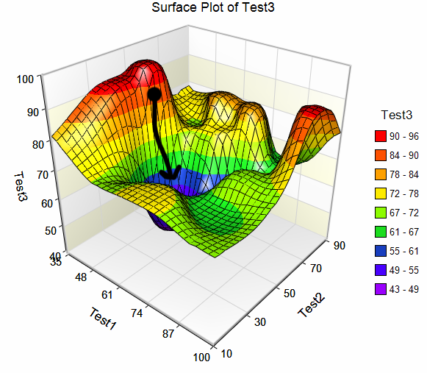
GRADIENT DESCENT
Neural Nets (with at least one hidden layer) may have many solutions for the cost function
Set your iterations as high as you can (without breaking your computer) to converge to the global minimum
Local minimum
Local minimum
Local minimum
Global Optimum

Slide 26
INTRODUCTION
BACK PROPAGATION WALKTHROUGH

Slide 27
BACK PROPAGATION
Consider the following example: (two classes: Red and Green)
How can we find a decision boundary to separate them?
x₂
x₁
d
x₁
W₁=?
y
W₂=?
Σ
x₂
W₀ = ?
X₀=1

Slide 28
BACK PROPAGATION
Random Initialization of perceptron weights
Calculate your error and use gradient descent to figure out how to adjust your line (aka adjust the weights) in order to decrease the error
x₂
x₁
d
x₁
W₁=?
y
W₂=?
Σ
x₂
W₀ = ?
X₀=1

Slide 29
BACK PROPAGATION
Calculate error of new line
Using Gradient Descent, adjust the line towards where the error is decreasing
x₂
x₁
d
x₁
W₁=?
y
W₂=?
Σ
x₂
W₀ = ?
X₀=1

Slide 30
BACK PROPAGATION
Using Gradient Descent, move the line towards where the error is decreasing
x₂
x₁
d
x₁
W₁=?
y
W₂=?
Σ
x₂
W₀ = ?
X₀=1

Slide 31
BACK PROPAGATION
Apply Iteratively Perceptron Training Rule on the different examples:
x₂
x₁
d
x₁
W₁=?
y
W₂=?
Σ
x₂
W₀ = ?
X₀=1

Slide 32
BACK PROPAGATION
Apply Iteratively Perceptron Training Rule on the different examples:
x₂
x₁
d
x₁
W₁=?
y
W₂=?
Σ
x₂
W₀ = ?
X₀=1

Slide 33
BACK PROPAGATION
All examples are correctly classified … stop Learning
x₂
x₁
d
x₁
W₁=?
y
W₂=?
Σ
x₂
W₀ = ?
X₀=1

Slide 34
BACK PROPAGATION
The straight line w₁x+ w₂y + w₀=0 separates the two classes
x₂
W₁x₁ + W₂x₂ +W₀ = 0
x₁
d
x₁
W₁=?
y
W₂=?
Σ
x₂
W₀ = ?
X₀=1

Slide 35
INTRODUCTION
EXAMPLE WITH HIDDEN LAYER

Slide 36
NEURAL NETWORKS
Example
Now suppose we have this data set. How would a neural network fit this data?
X2
X1

Slide 37
NEURAL NETWORKS
Example
We could try using two decision boundaries
X2
We want a decision function that says…
“If it’s between L1 and L2, then it’s a square. Else, it’s a circle”
Or, “If it’s greater than L2 OR less than L1, then it’s a circle. Else, it’s a square”
Can Neural Nets do this?
X1
L1
L2

Slide 38
NEURAL NETWORKS
A Neural Network with two decision boundaries uses two perceptrons: L1 and L2.
Using back propagation it separates the two classes best with these lines
X2
Perceptron
1
(L1)
Output
Perceptron
2
(L2)
X1
L1
L2

Slide 39
NEURAL NETWORKS
We can define the final output by looking at the results of each of our decision boundaries
Perceptron
1
(L1)
Output
X2
Perceptron
2
(L2)
Perceptron 1 value | Perceptron 2 value | Final Output Value
0 = not circle | 0 = not circle | 0 = Square
0 = not circle | 1 = circle | 1 = Circle
1 = circle | 0 = not circle | 1 = Circle
1 = circle | 1 = circle | 1 = Circle
X1
L1
L2

Slide 40
NEURAL NETWORKS
Developing a decision boundary in the hidden layer looks something like this
Perceptron 1 value | Perceptron 2 value | Final Output value
0 | 0 | 1
0 | 1 | 0
1 | 0 | 0
1 | 1 | 0
Perceptron
1
Perceptron
1
(L1)
Output
(L3)
Perceptron
2
(L2)
Perceptron
2
L3

Slide 41
INTRODUCTION
HIDDEN LAYERS: INTUITION

Slide 42
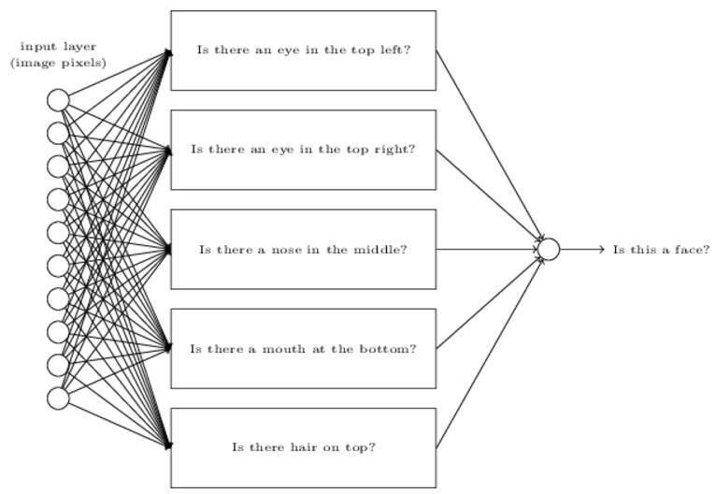

NEURAL NETWORKS
A Deep Net is a neural network that simply has two or more hidden layers
What are the hidden layers doing? => Breaking down the problem into sub-problems
End result is a network that breaks down a complex question into very simple questions
Input data
http://neuralnetworksanddeeplearning.com/chap1.html

Slide 43

NEURAL NETWORKS
Hidden layers extract different layers of patterns.
Each hidden layer gets more detailed and specific about the patterns
Feature representation
3rd layer
“Objects”
Input data
2nd layer
“Object parts”
1st layer
“Edges”
Pixels
[Lee et al., ICML’09]

Slide 44
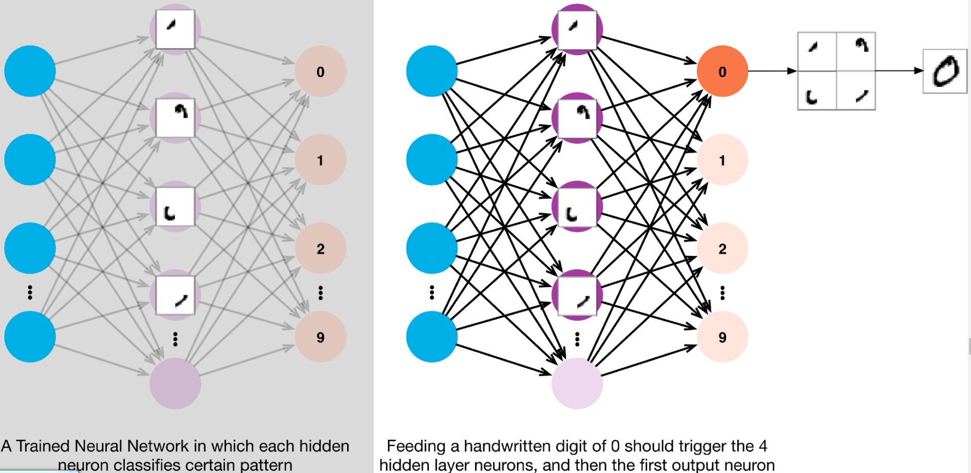
NEURAL NETWORKS
In the case of identifying handwritten digits using a neural network, you can look at the hidden layers recognizing patterns in the digits:

Slide 45
CONCLUSION
TYPES OF NEURAL NETWORKS

Slide 46
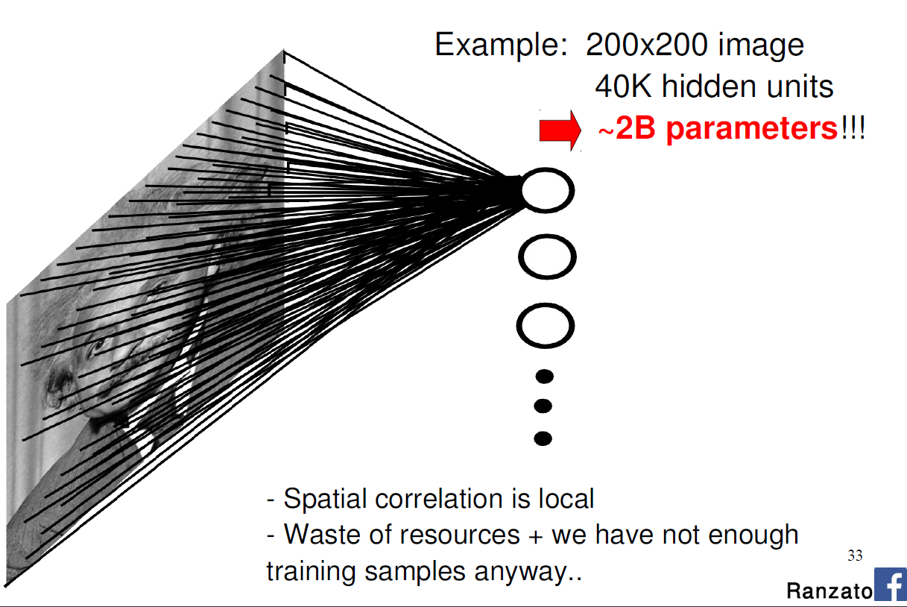
NEURAL NETWORKS
Fully Connected Network
Every node is an input for the next node

Slide 47
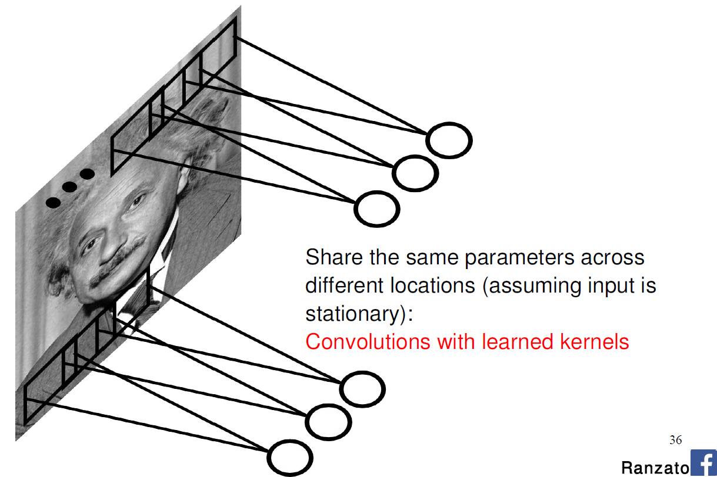
NEURAL NETWORKS
Convolutional Neural Network
Create things called “feature-maps” in order to summarize pixels
Lessens the processing time when fitting
Only makes sense when the data is spatial (good for image processing)

Slide 48
CONCLUSION
THINGS TO NOTE

Slide 49
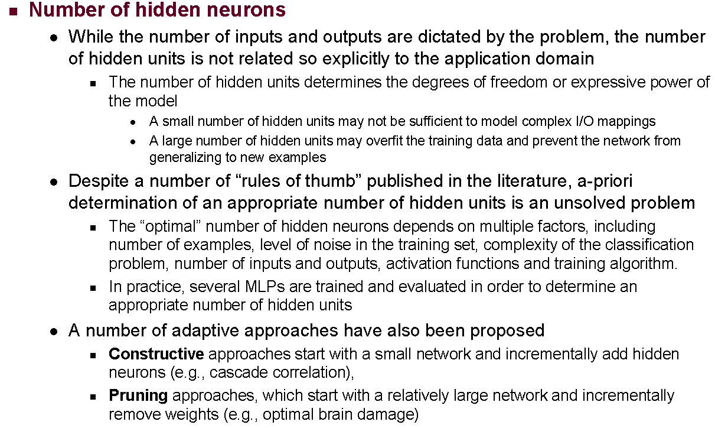
NEURAL NETWORKS: CONCERNS

Slide 50
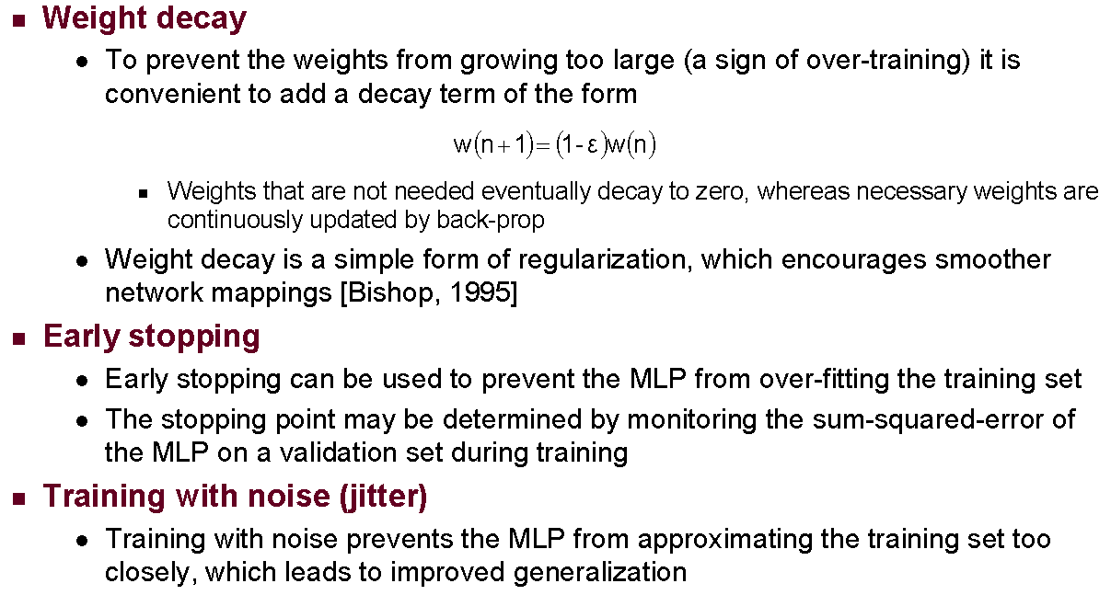
NEURAL NETWORKS: CONCERNS

Slide 51
CONCLUSION
TOPIC REVIEW

Slide 52
REVIEW Q&A
What is the process called in which we develop our decision boundary(s)?
What does adding a perceptron to a layer do in practical terms?
How do we find the optimal # of hidden layers/perceptrons to have in our model?

